Slide 1
Project4 - HAWA
Jason Zhang
Demo Video: https://broadcast.amazon.com/videos/1204983

Slide 2
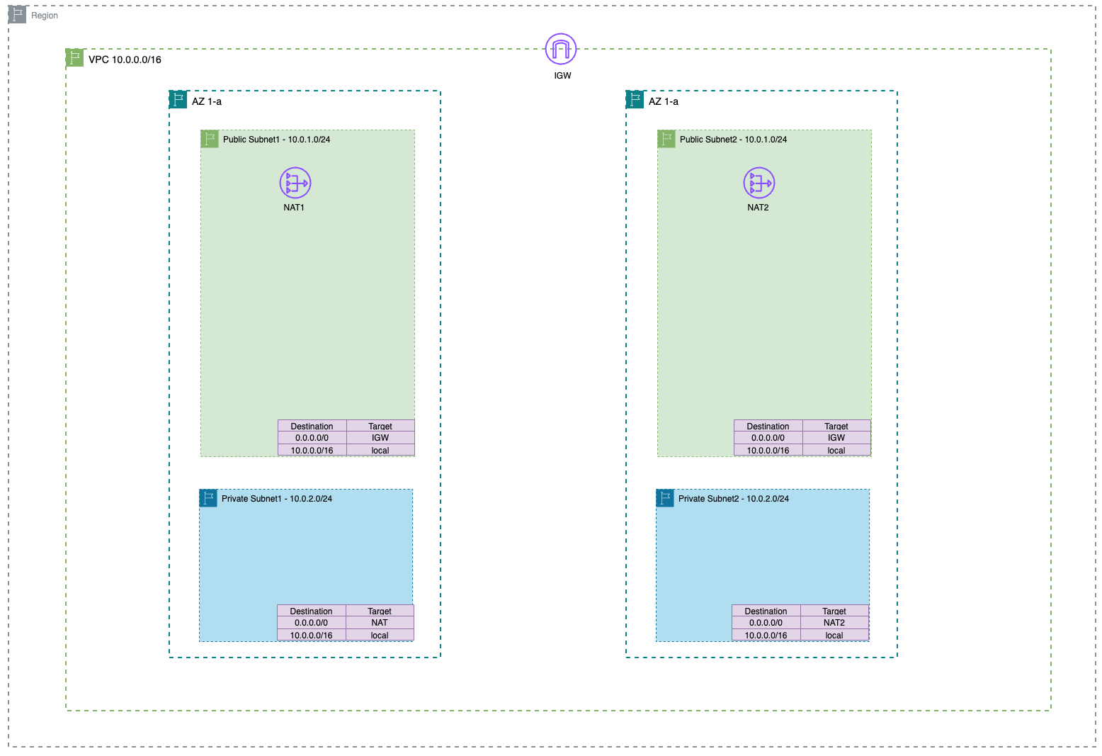
VPC
Configuration

Slide 3
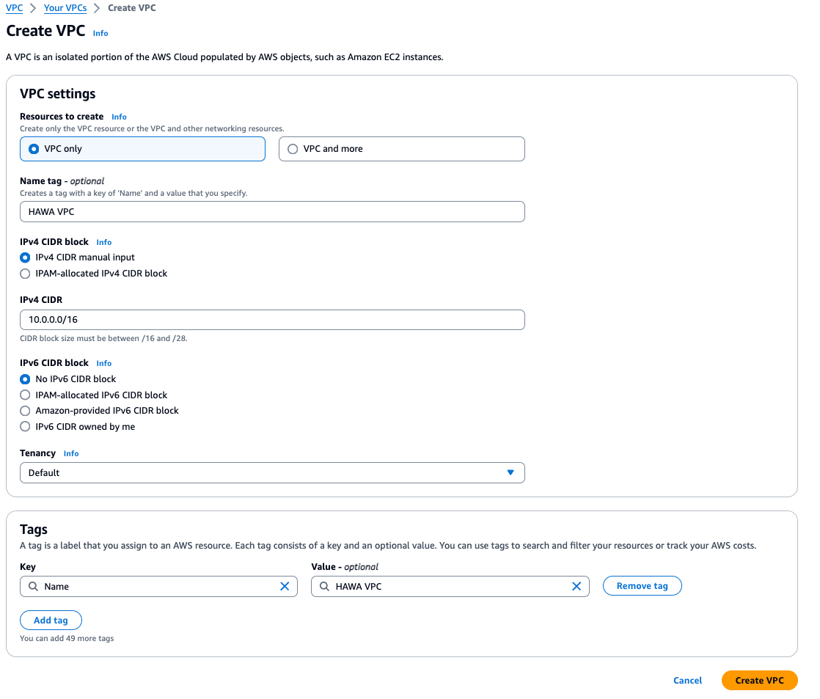
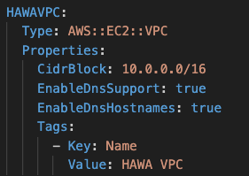
Step 1 - vpc
Notes:
EnableDnsSupport:
When set to true, this property enables DNS resolution in the VPC.
It allows resources within the VPC to use DNS names to communicate with other resources, instead of relying solely on IP addresses.
This is typically enabled for convenience and ease of use when working with resources within the VPC.
EnableDnsHostnames:
When set to true, this property enables DNS hostnames for instances launched in the VPC.
It assigns a DNS hostname to each instance launched in the VPC, which can be used for communication instead of IP addresses.
The DNS hostname follows the pattern ip-<private-ip-address>.ec2.internal, where <private-ip-address> is the private IP address of the instance.

Slide 4
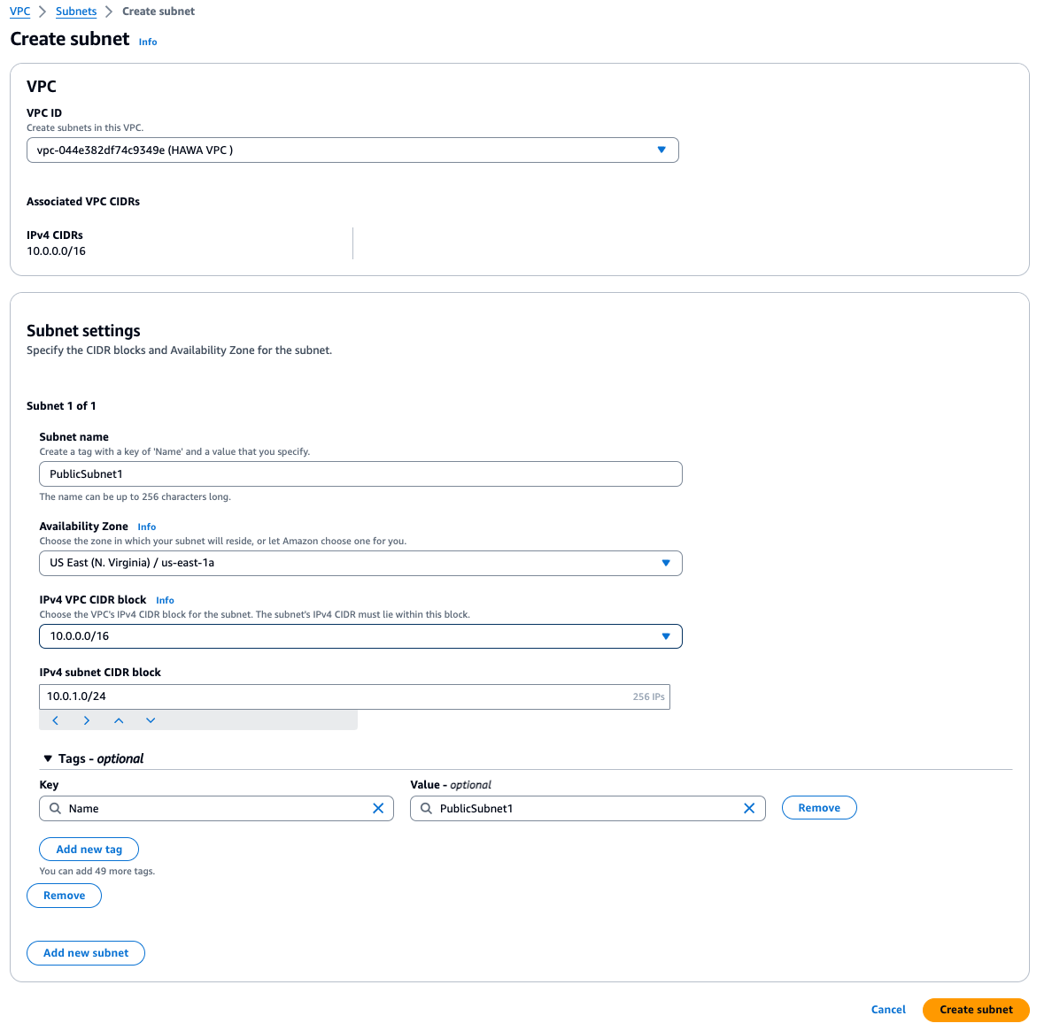
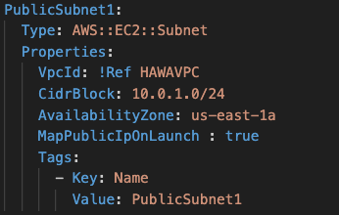
Step 2.1 - vpc

Slide 5
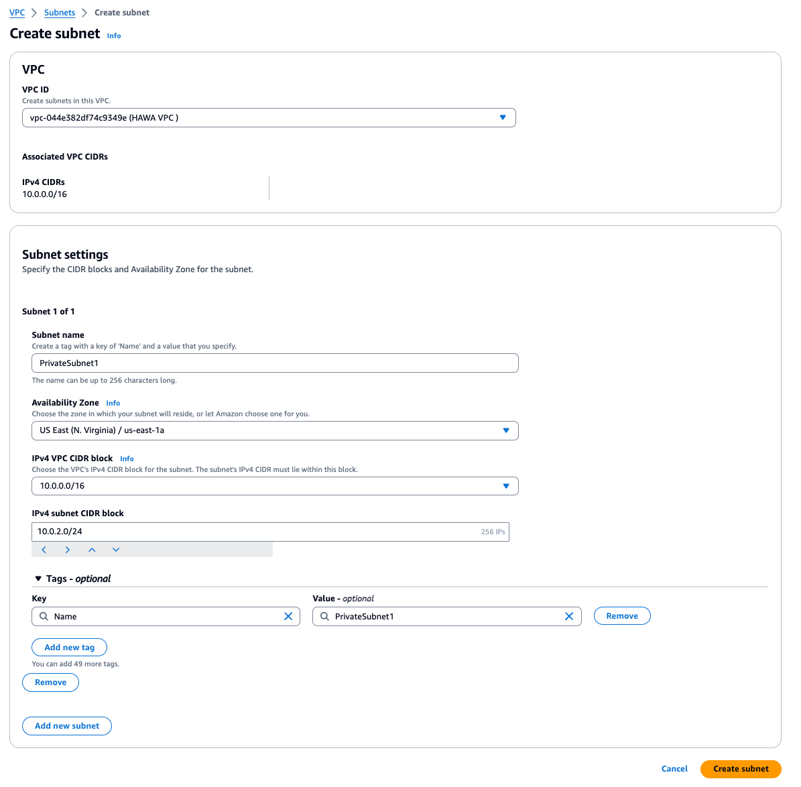
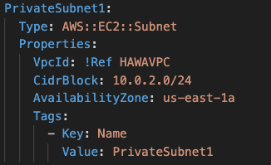
Step 2.2 - vpc

Slide 6
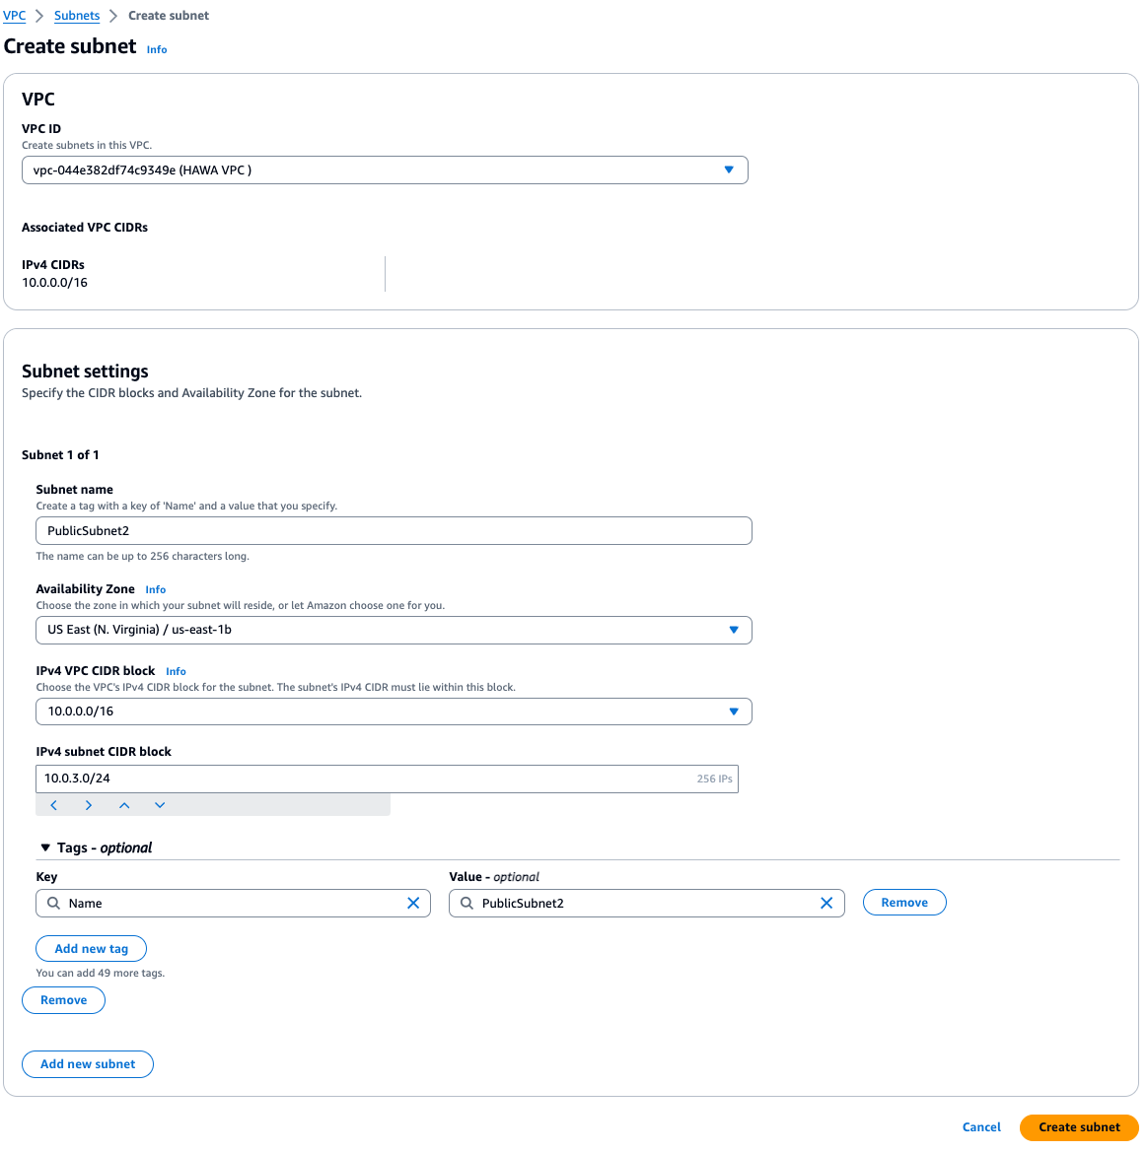
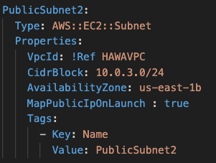
Step 2.3 - vpc

Slide 7

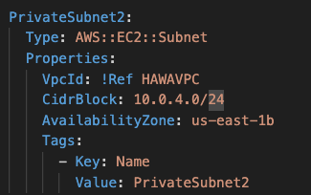
Step 2.4 - vpc

Slide 8
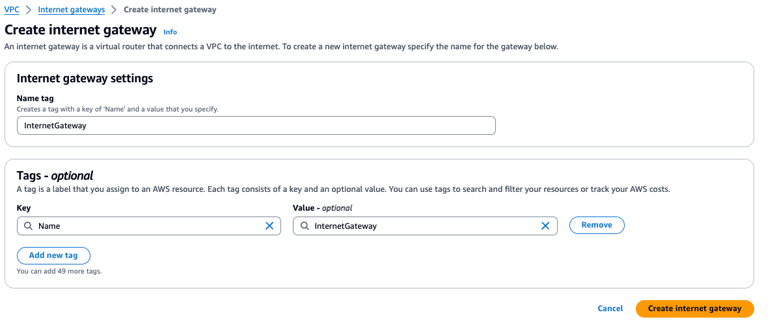
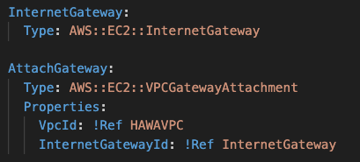
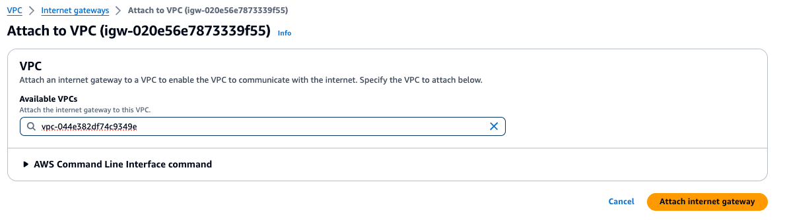
Step 3 - vpc
Notes:
Internet Gateway first then Nat, other will fail to create NAT (Network vpc-044e382df74c9349e has no Internet gateway attached)

Slide 9
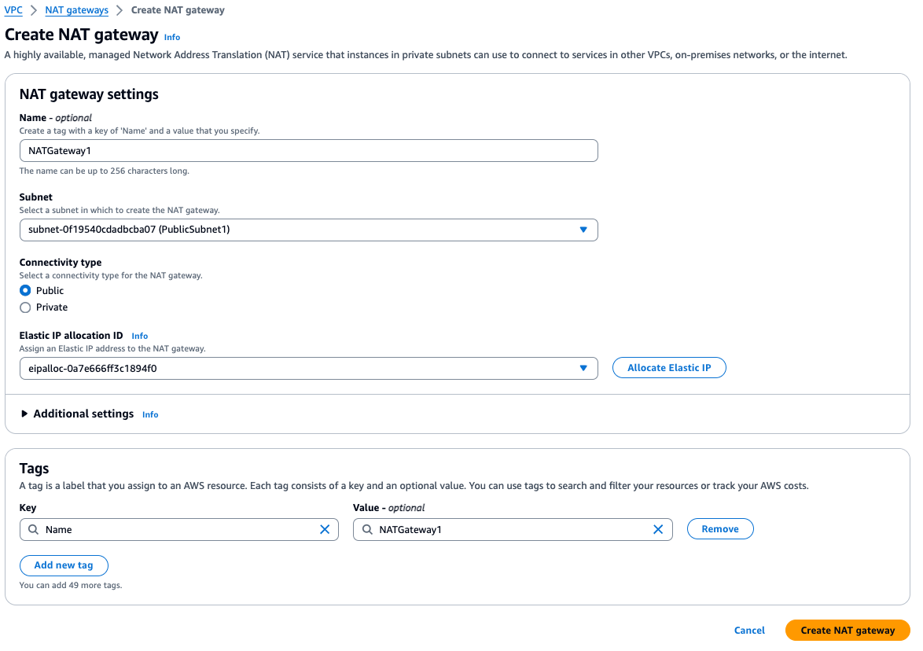
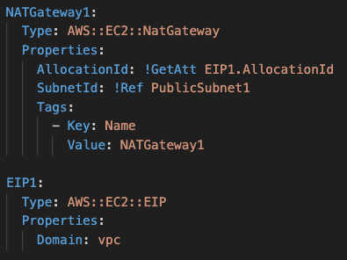
Step 4.1 - vpc

Slide 10
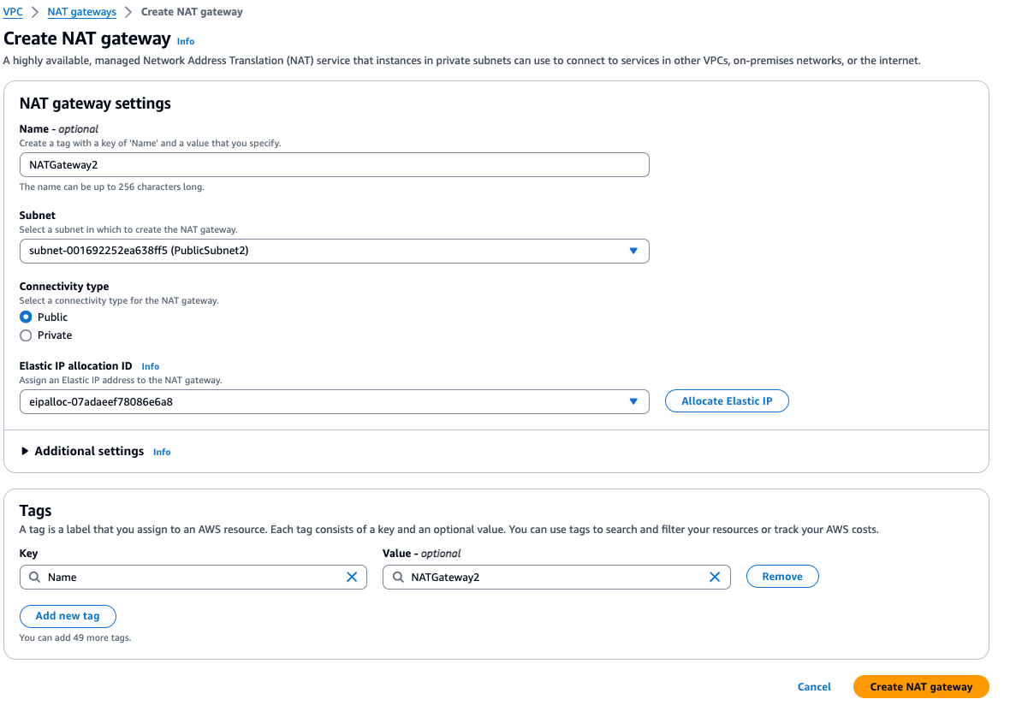
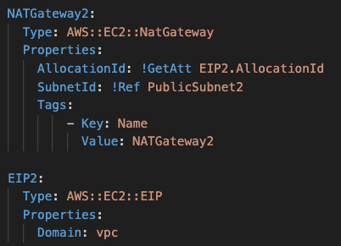
Step 4.2 - vpc

Slide 11
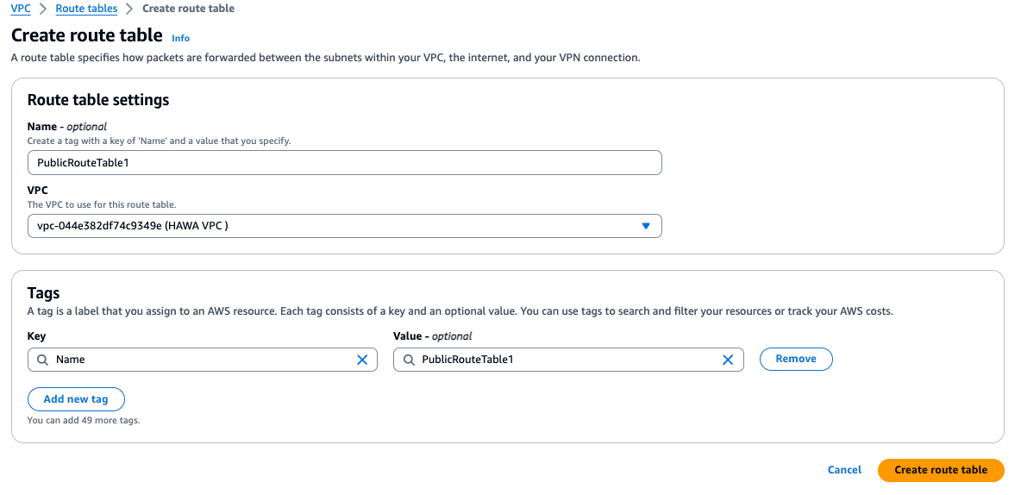
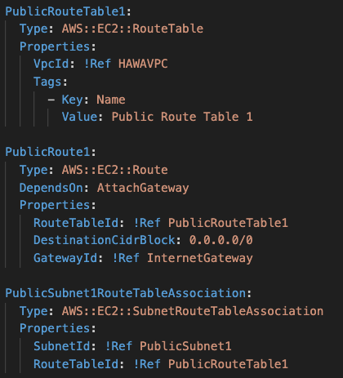
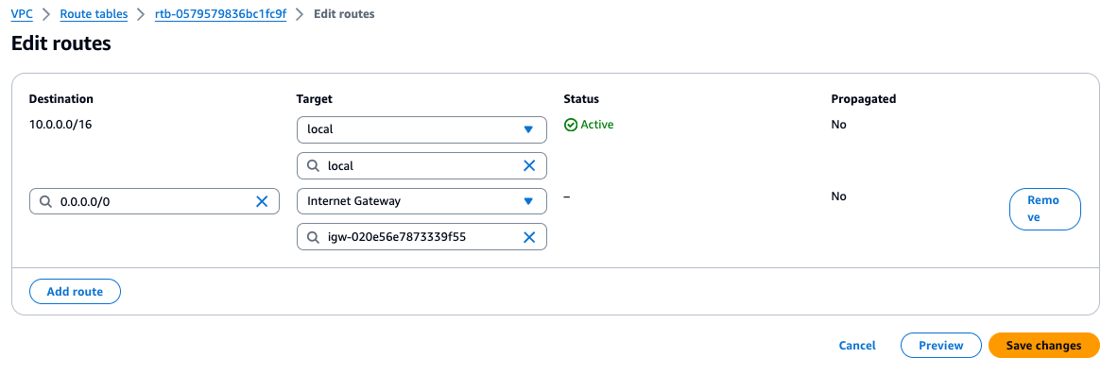
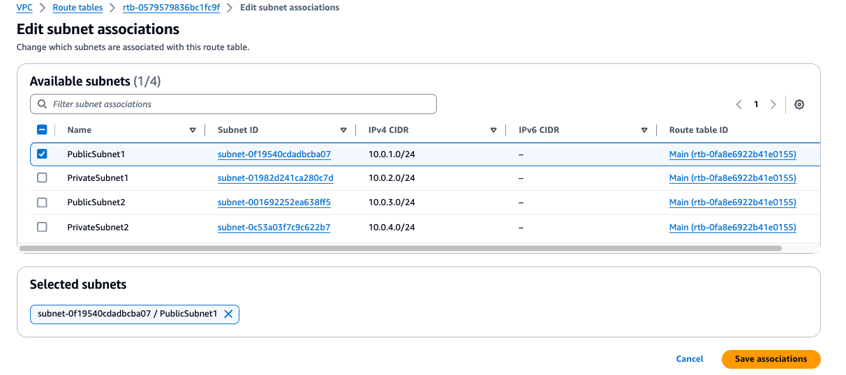
Step 5.1 - vpc

Slide 12
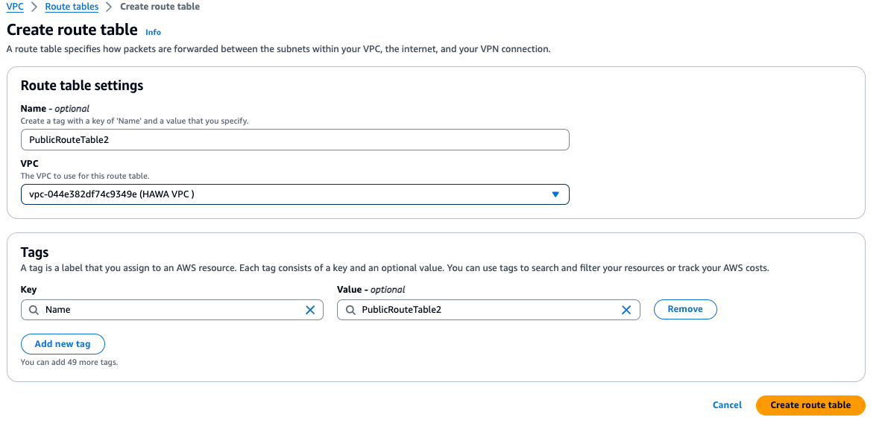
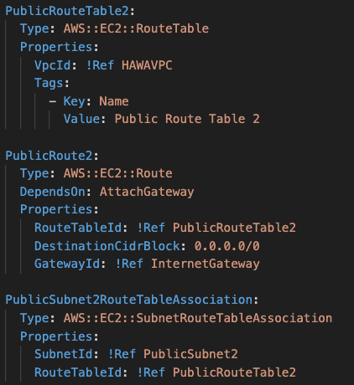
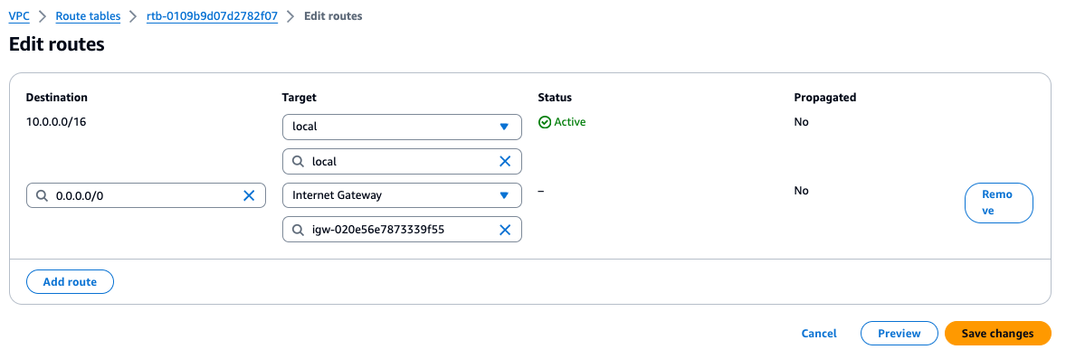
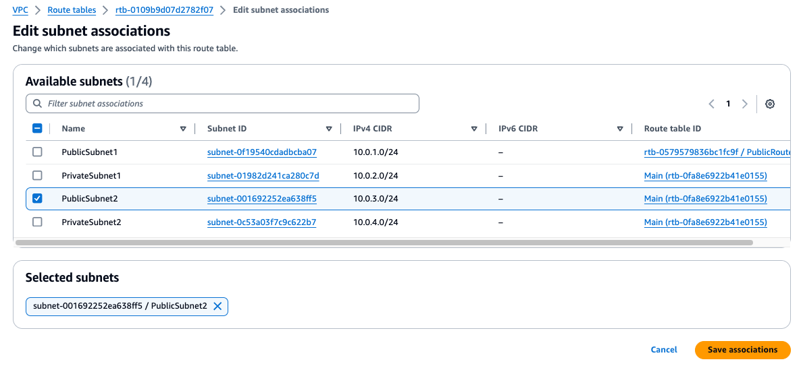
Step 5.2 - vpc

Slide 13
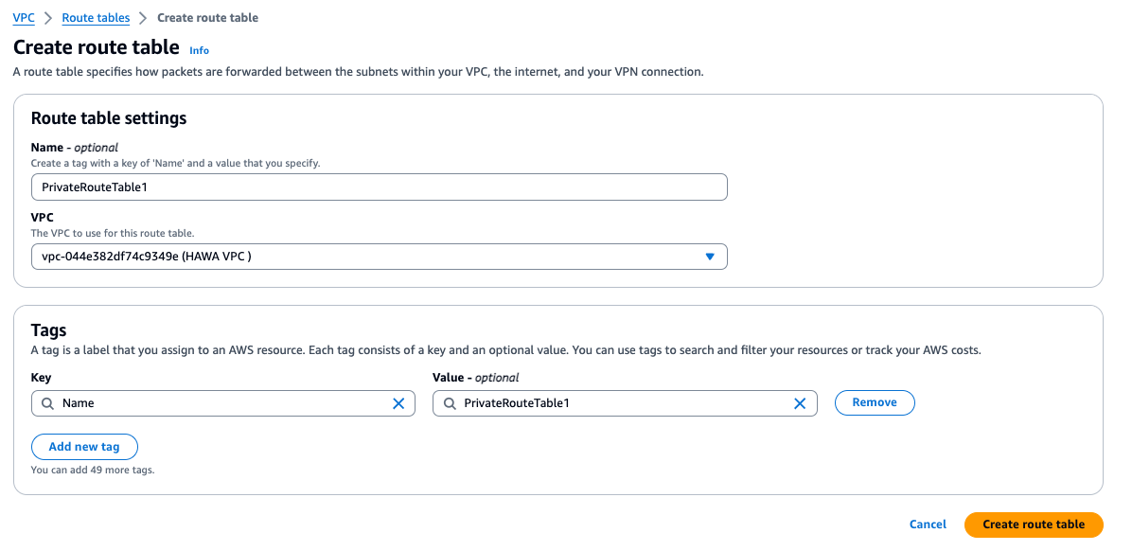
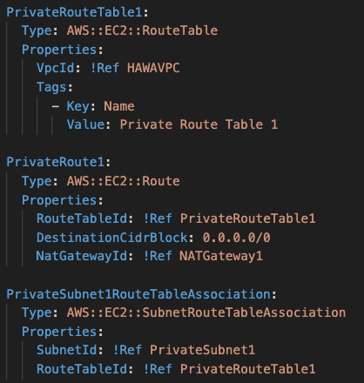
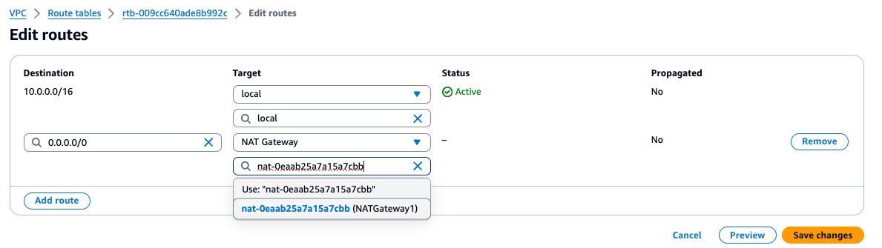
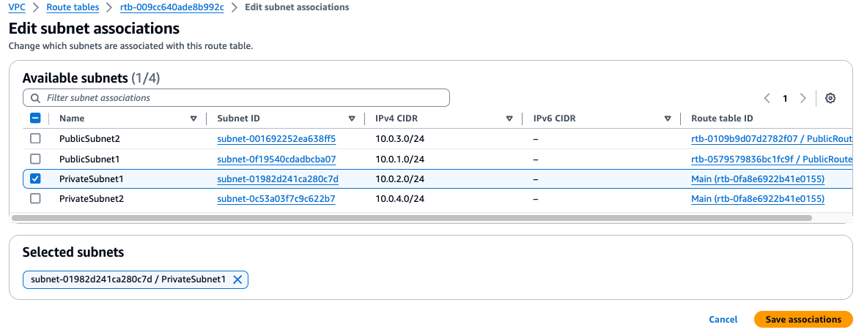
Step 6.1 - vpc

Slide 14
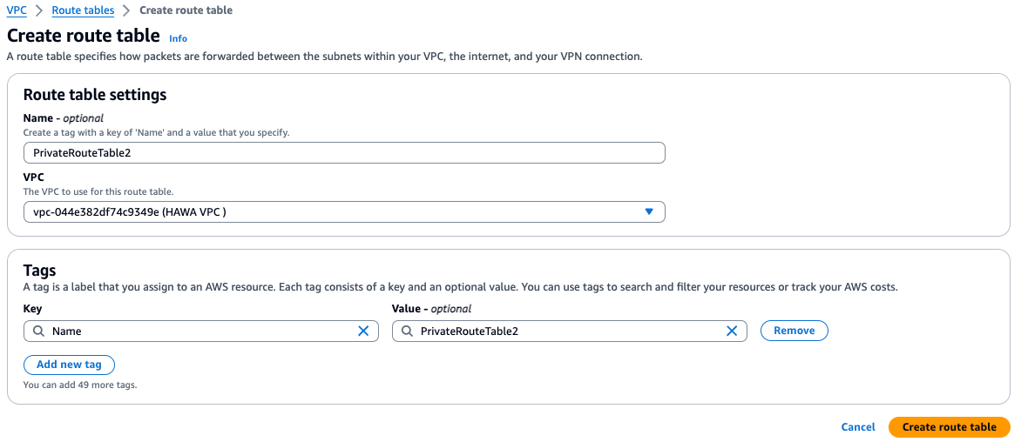
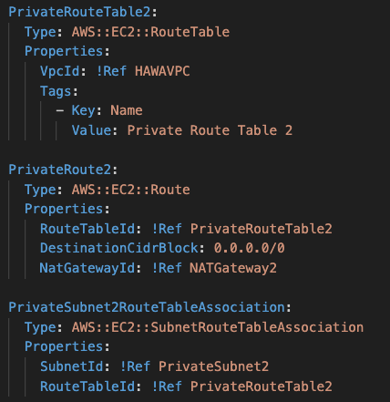
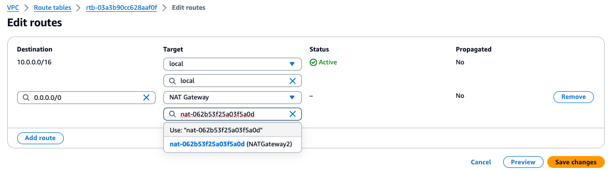
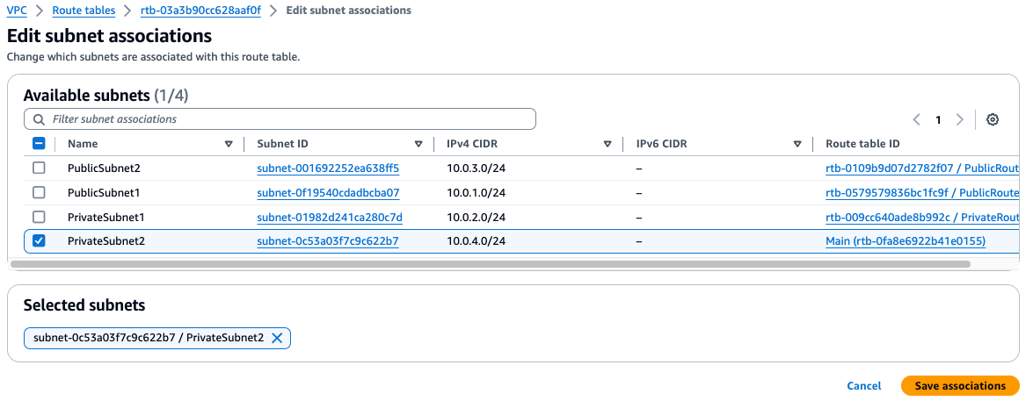
Step 6.2 - vpc

Slide 15
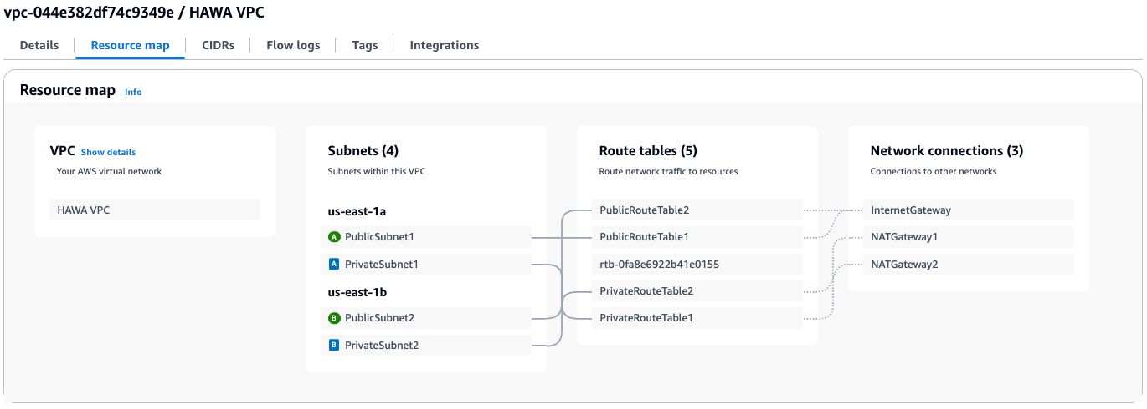
VPC
summary

Slide 16
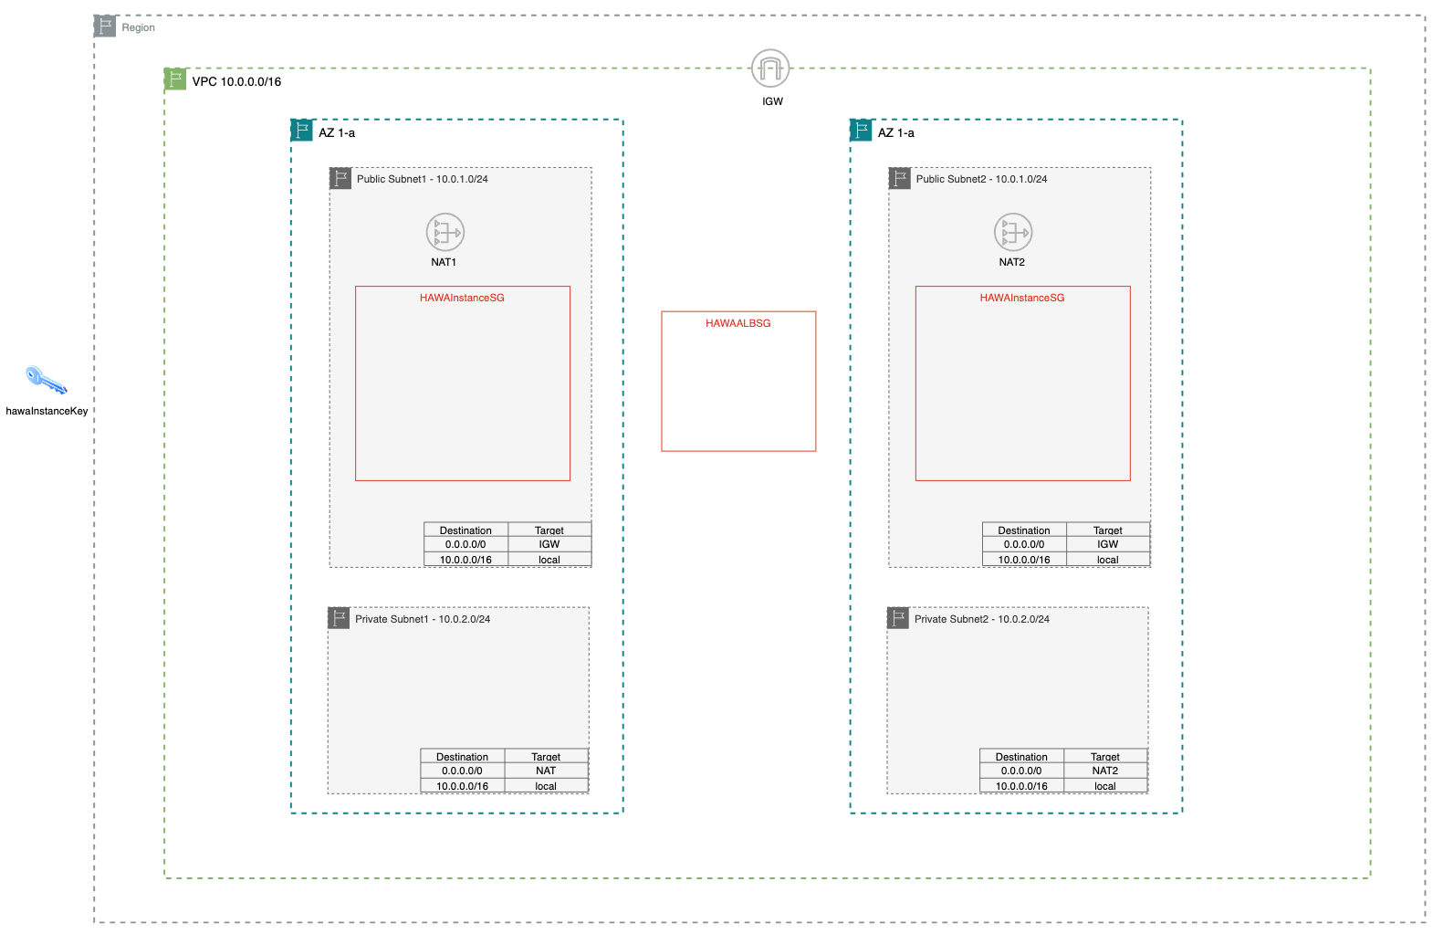
SG & Key
Configuration

Slide 17
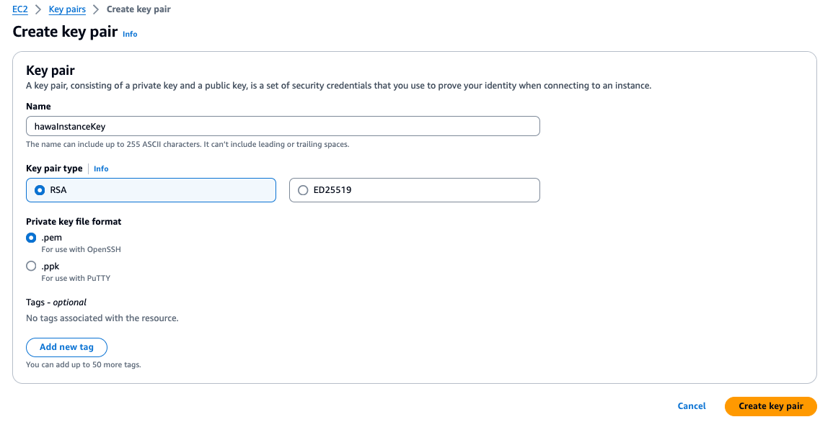
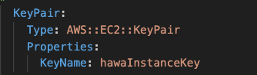
Step 1 – SG & Key

Slide 18
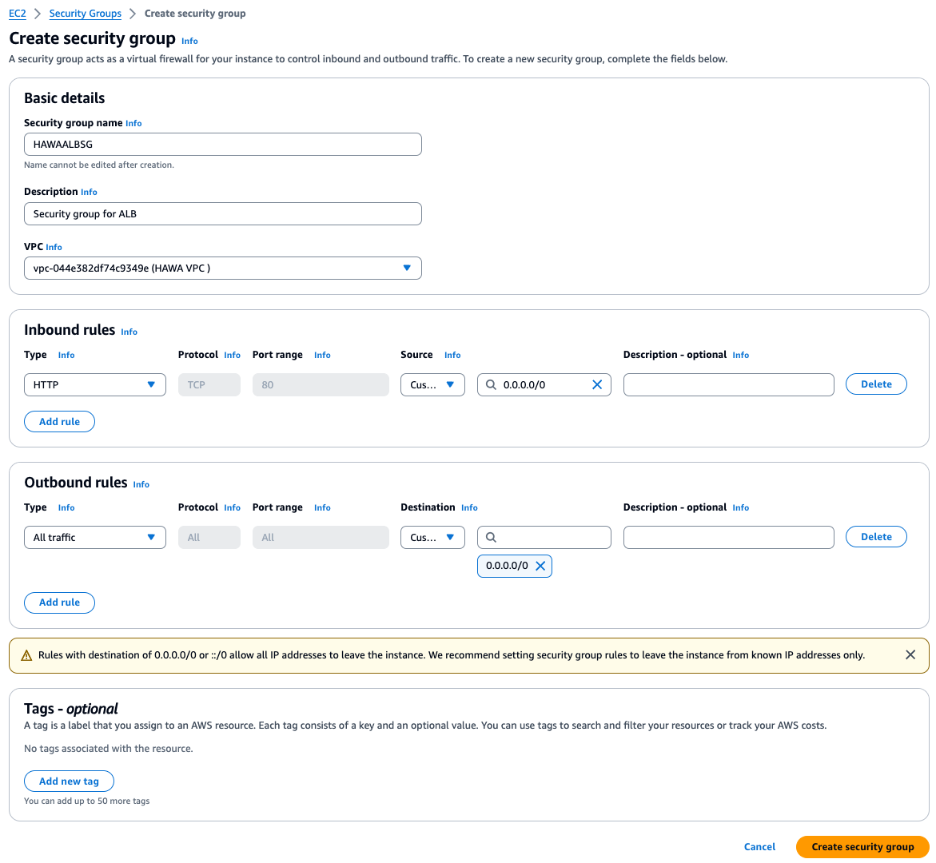
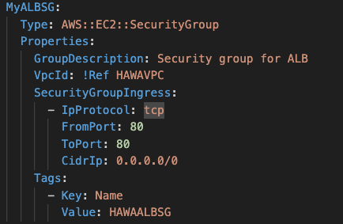
Step 2 – SG & Key

Slide 19
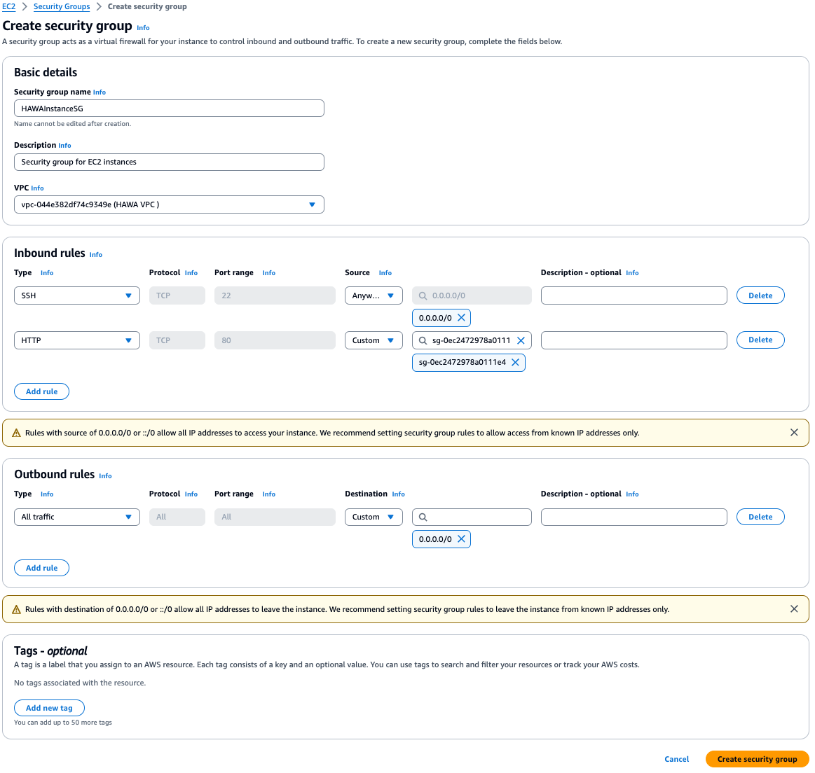
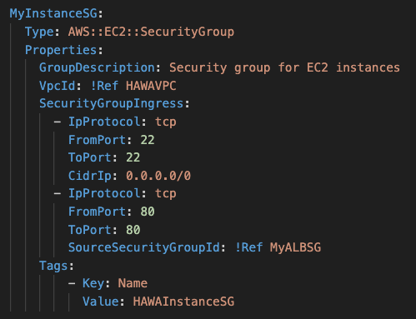
Step 3 – SG & Key

Slide 20
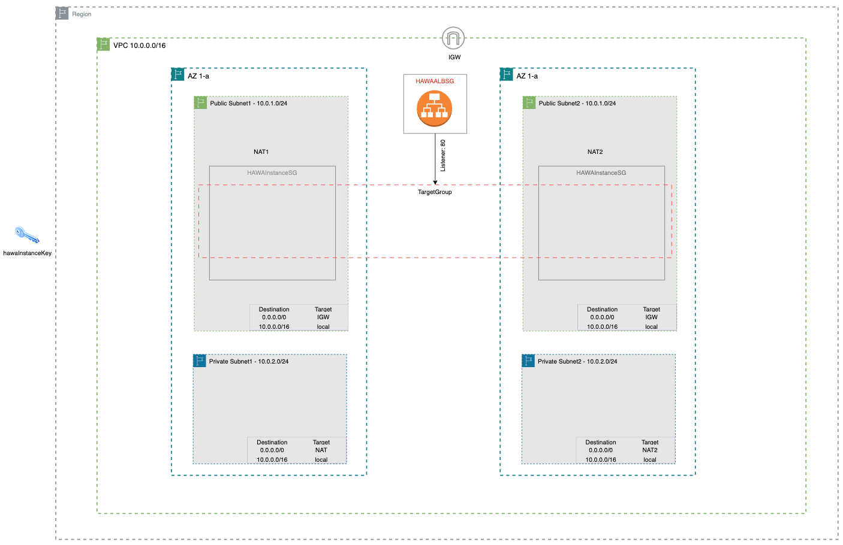
ALB
Configuration

Slide 21
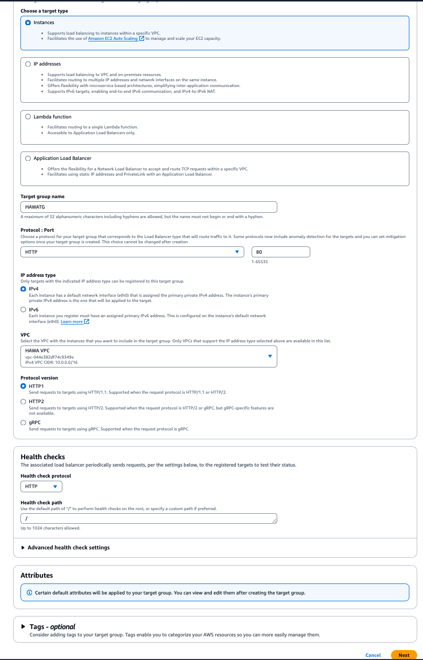
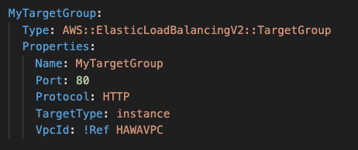
Step 1 – ALB

Slide 22
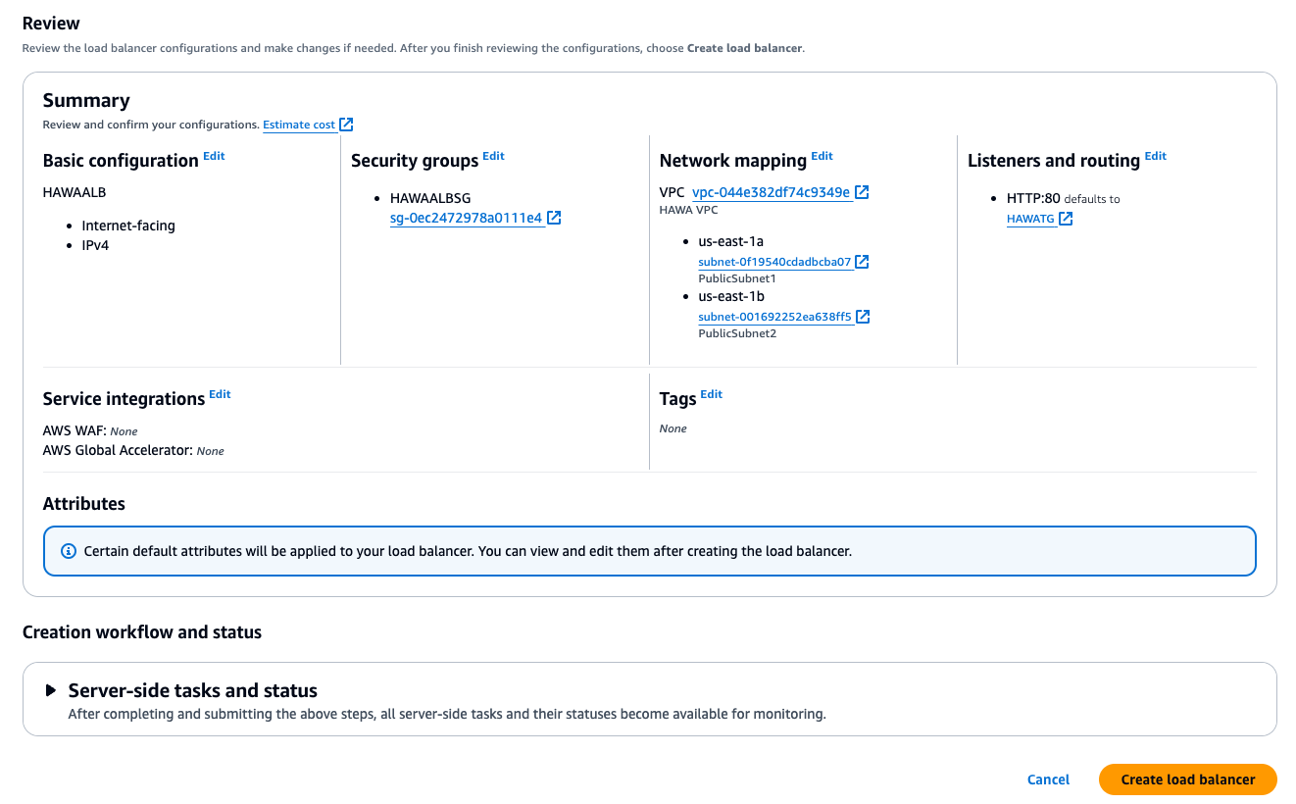
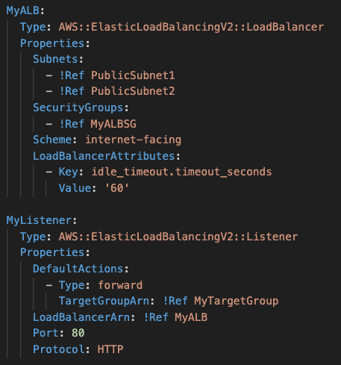
Step 2 – ALB

Slide 23
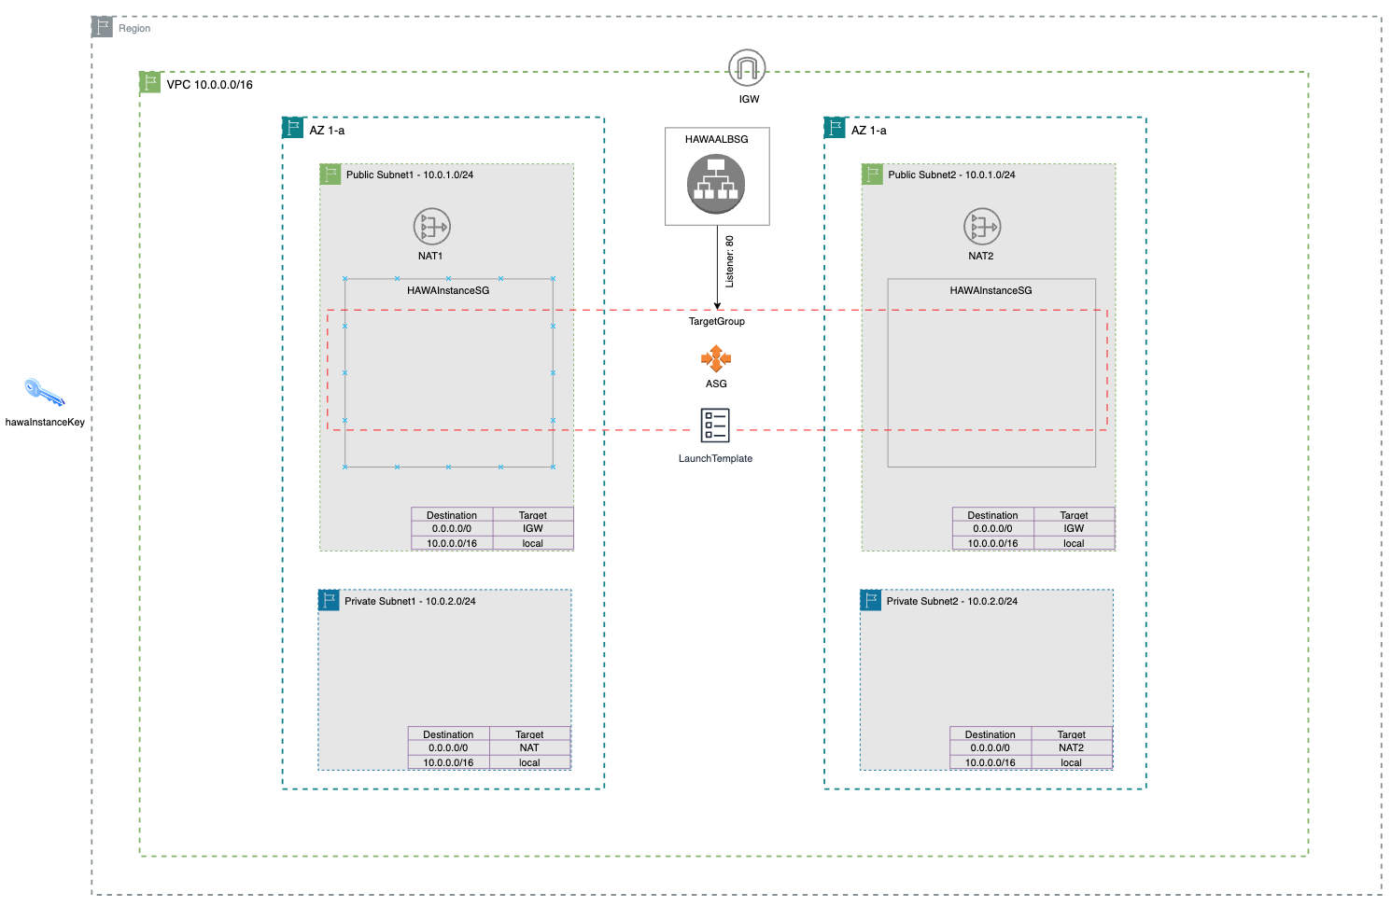
ASG
Configuration

Slide 24
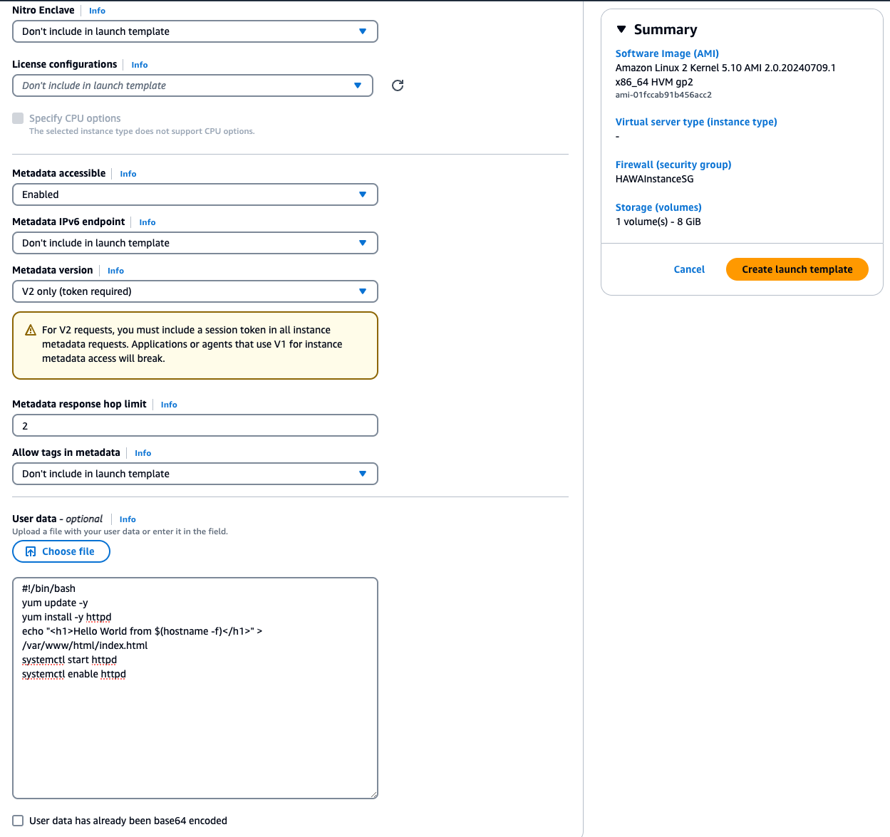
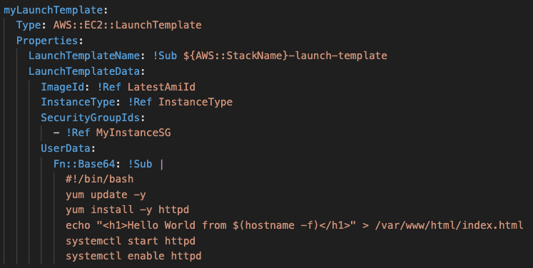
Step 1 – ASG

Slide 25
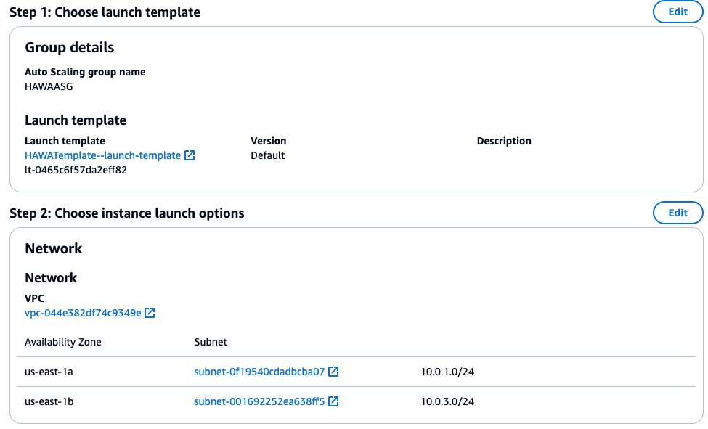



Step 2 – ASG

Slide 26


Thank You!
Jason Zhang

